Slide 1
Search for Top Squarks via All-hadronic Decay Channels with Heavy Object Tagging
Matthew Kilpatrick
Doctoral Candidate
Rice University

Slide 2
Outline
Standard Model
What is it?
Dark Matter
Why SUSY?
Compact Muon Solenoid
Different methods of detection
All-hadronic Top Squark Search
Kinematic Variables
Search region design
Background estimation

Slide 3
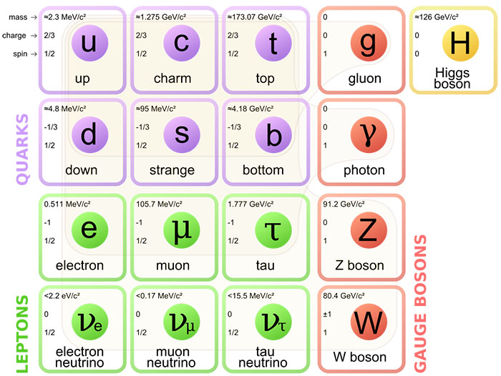
Standard Model
Notes:
Don’t get too detailed! Quarks interact with the strong force and Electromagnetism. Charged leptons interact with electromagnetism, neutrinos only interact with the weak force. The mediators of these forces are the gluon, photon, W and Z bosons. This Higgs boson, discovered in 2012 is a scalar boson whose field give mass to the particles.

Slide 4

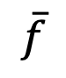
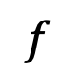
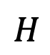
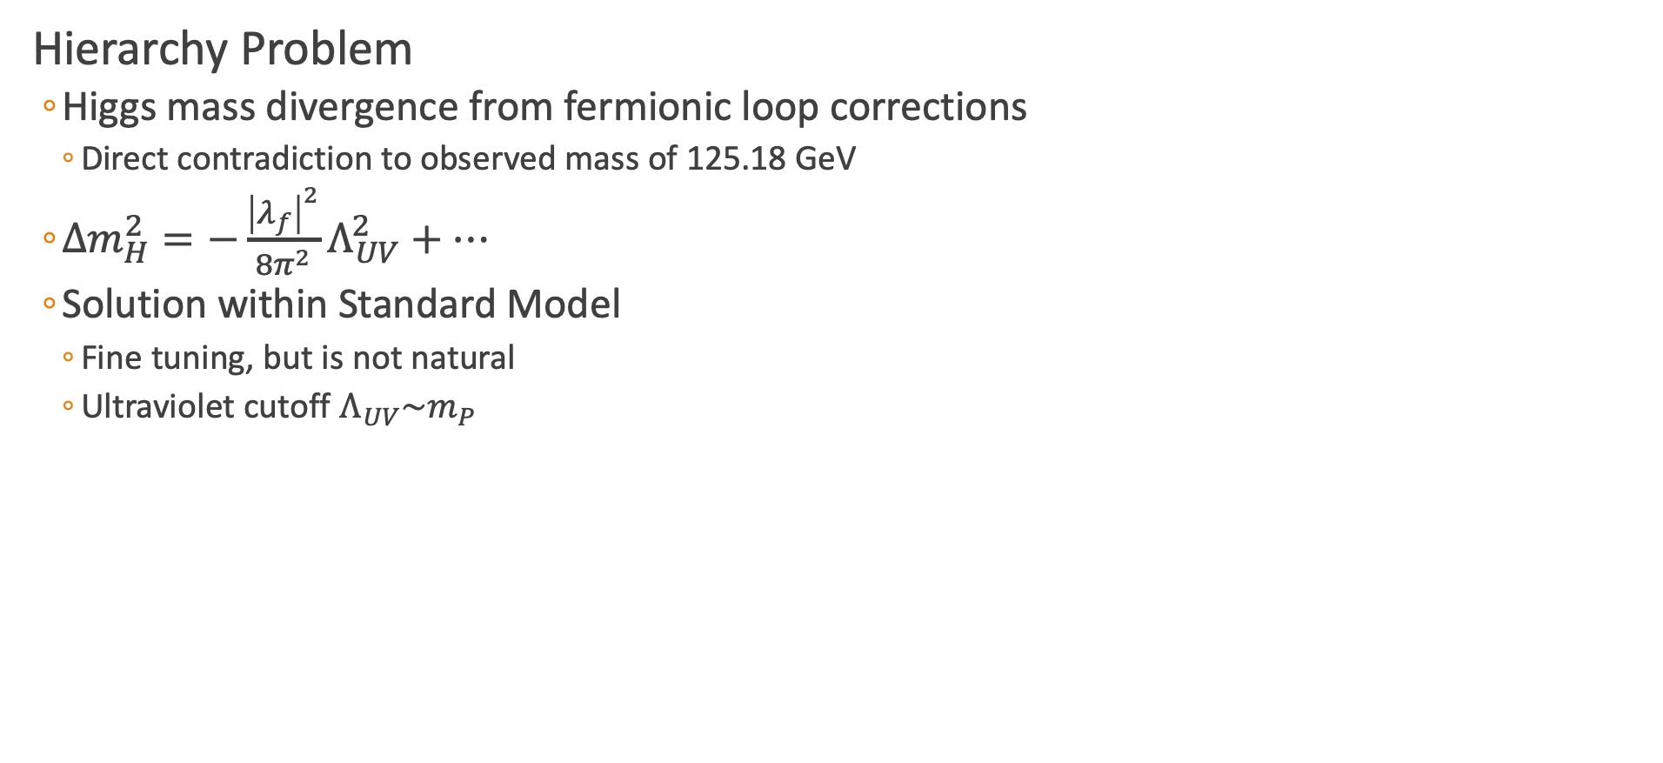
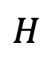
Hierarchy Problem
Hierarchy Problem
Higgs mass divergence from fermionic loop corrections
Direct contradiction to observed mass of 125.18 GeV
$Δm_{H}^{2}=−\frac{{\left|λ_{f}\right|}^{2}}{8π^{2}}Λ_{UV}^{2}+⋯$
Solution within Standard Model
Fine tuning, but is not natural
Ultraviolet cutoff $Λ_{UV}\sim m_{P}$
$$f$$
$$H$$
$$H$$
$$\overline{f}$$
arXiv: hep-ph/9709356

Slide 5
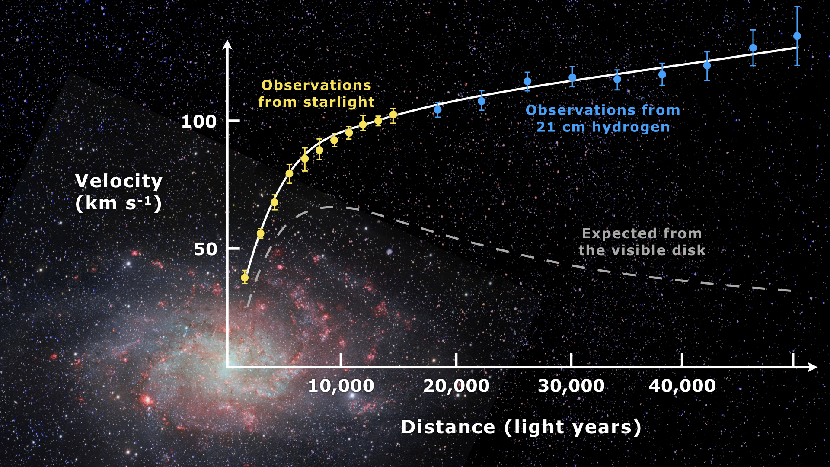
Dark Matter
Galactic Velocity Curves
Large radial velocity
Not explainable with visible matter
Either:
Modified Newtonian Dynamics
“Dark matter” interacting gravitationally
Gravitational Lensing
Mass curves spacetime
Gravitational lens methods to find total amount of matter
Disagreement with visible matter
arXiv:astro-ph/9909252
doi:10.1086/158003.
Notes:
MOND: Newtonian mechanics tested at large accelerations, but not
21 cm hydrogen: due to spin flip of electron in hydrogen, anti-aligned to aligned nuclear-electron spins

Slide 6
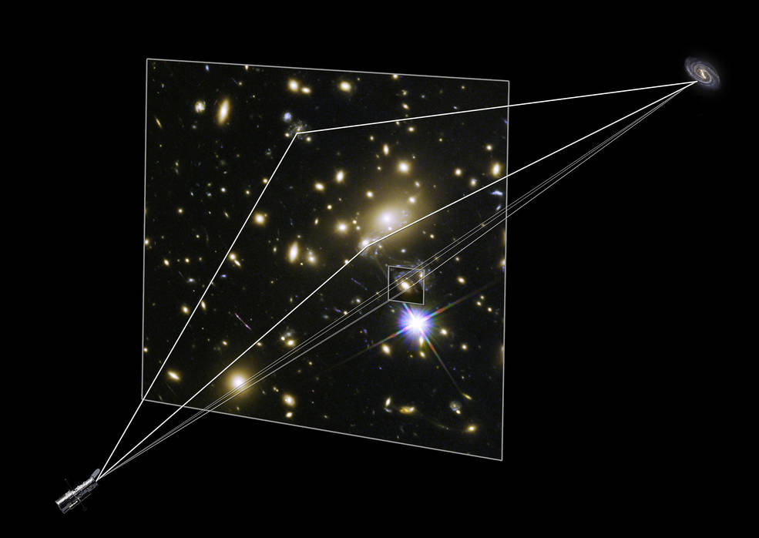
Dark Matter
Galactic Velocity Curves
Large radial velocity
Not explainable with visible matter
Either:
Modified Newtonian Dynamics
“Dark matter” interacting gravitationally
Gravitational Lensing
Mass curves spacetime
Gravitational lens methods to find total amount of matter
Disagreement with visible matter

Slide 7
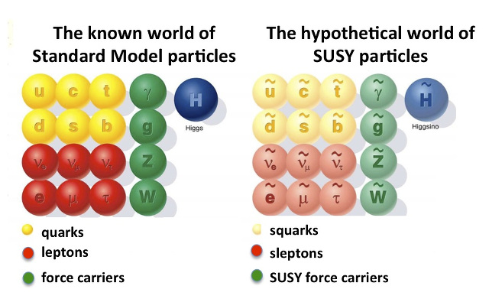
What does Supersymmetry potentially solve?
What is Supersymmetry?
Fermion-bosonic partnership
For every fermion there is a boson partner, and vice-versa
Exact same quantum numbers except spin
Naming:
“s” in front of name, meaning scalar partner
“ino” at end of name, meaning fermionic partner
Where are all of these particles?
Notes:
Quantum Numbers: Charge, weak isospin, weak hypercharge, color

Slide 8
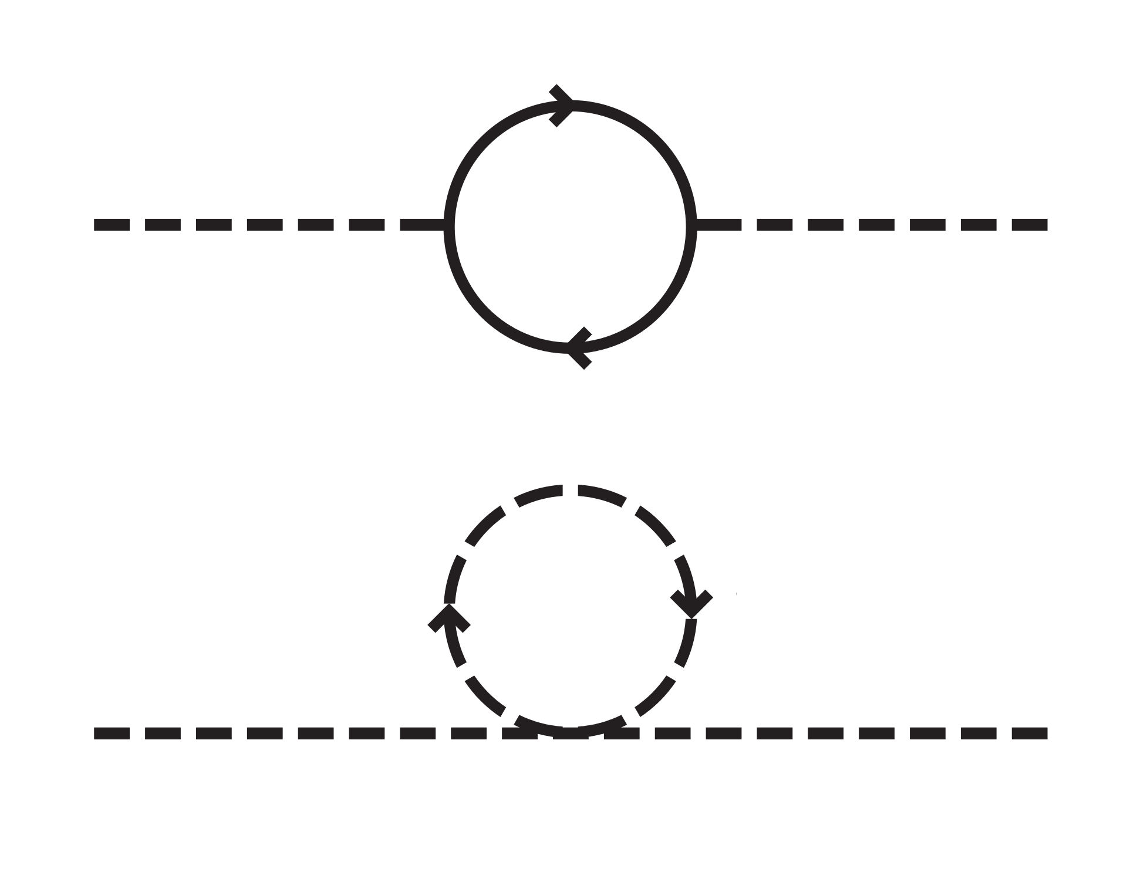
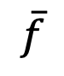
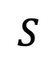
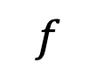
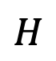
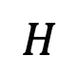
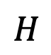
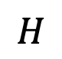
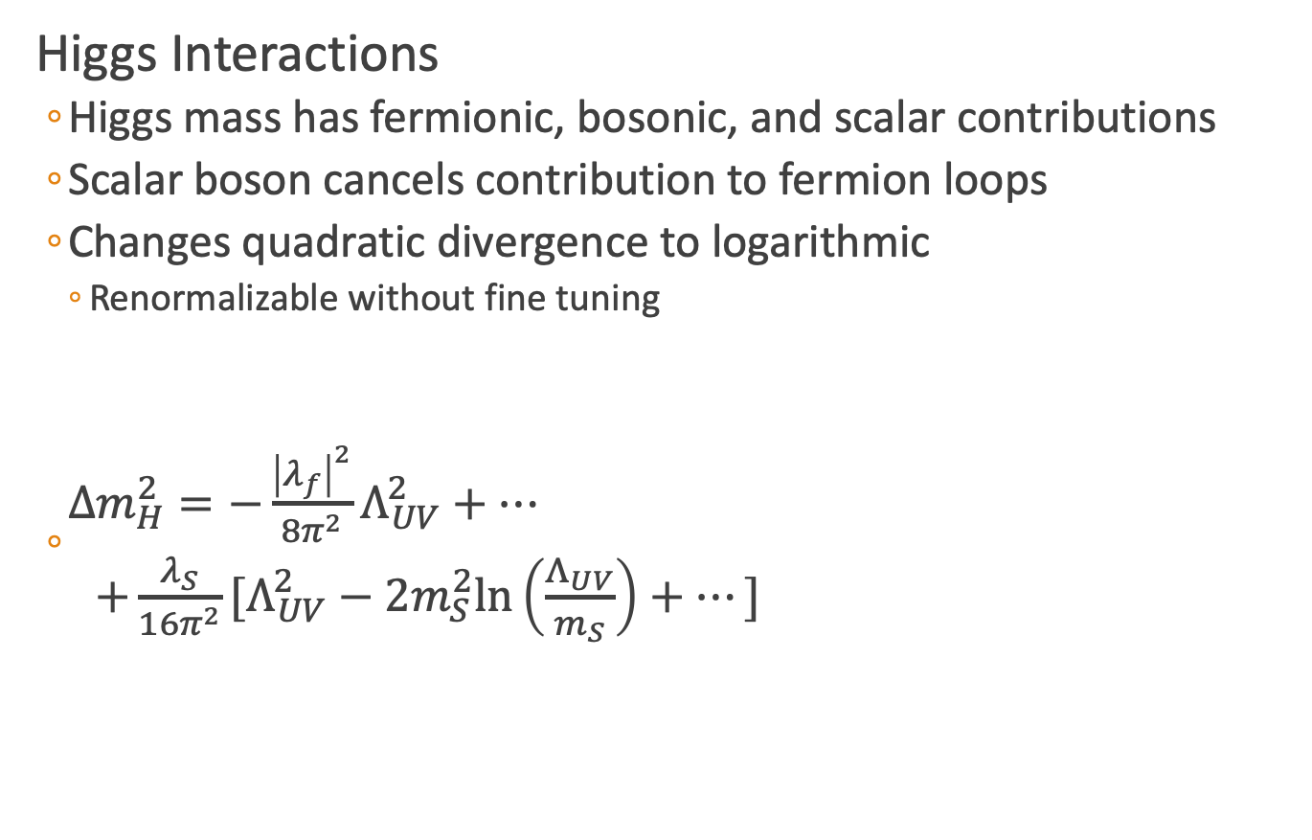
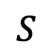
Hierarchy Solution
Higgs Interactions
Higgs mass has fermionic, bosonic, and scalar contributions
Scalar boson cancels contribution to fermion loops
Changes quadratic divergence to logarithmic
Renormalizable without fine tuning
$\begin{matrix}Δm_{H}^{2}=−\frac{{\left|λ_{f}\right|}^{2}}{8π^{2}}Λ_{UV}^{2}+⋯ \\ +\frac{λ_{S}}{16π^{2}}[Λ_{UV}^{2}−2m_{S}^{2}\text{ln}\left(\frac{Λ_{UV}}{m_{S}}\right)+⋯] \end{matrix}$
$$f$$
$$H$$
$$H$$
$$\overline{f}$$
$$S$$
$$S$$
$$H$$
$$H$$
arXiv: hep-ph/9709356
Notes:
Log renormalization: Due to loop correction you get an integral that diverges. Thank fully the log can be consumed by the coupling for the interaction as long as there is a cut of at large mass scales.
This causes a running coupling that changes that force as a function of momentum

Slide 9
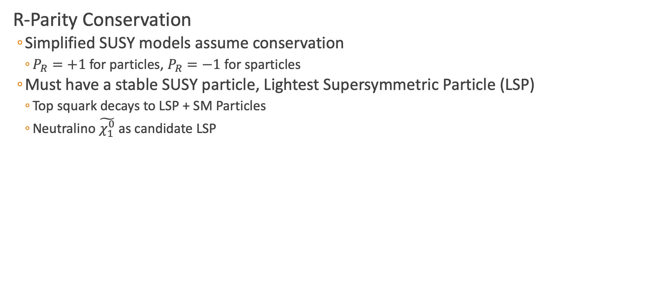
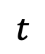
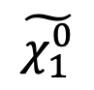
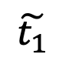
Dark Matter Candidate
R-Parity Conservation
Simplified SUSY models assume conservation
$P_{R}=+1$ for particles, $P_{R}=−1$ for sparticles
Must have a stable SUSY particle, Lightest Supersymmetric Particle (LSP)
Top squark decays to LSP + SM Particles
Neutralino $\tilde{χ_{1}^{0}}$ as candidate LSP
$$t$$
$$\tilde{t_{1}}$$
$$\tilde{χ_{1}^{0}}$$
Notes:
P_R = (-1)^3(B-L)+2s

Slide 10
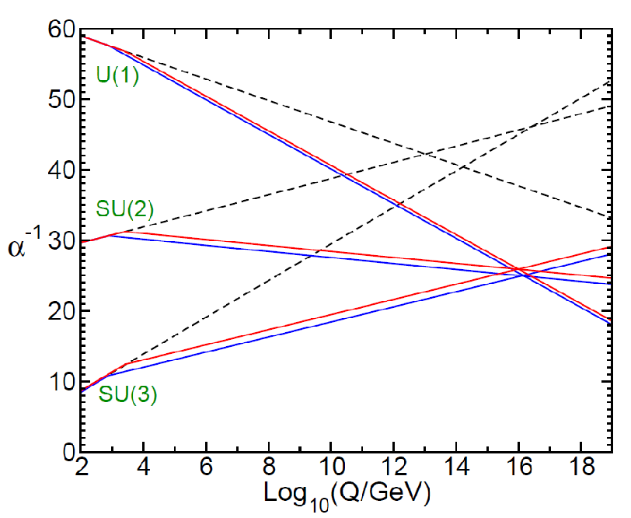
Grand Unified Theory
Supersymmetry predicts for unification at large energy scales
EM
Weak
Strong
Notes:
Two loop renormalization group evolution of the inverse gauge couplings $α_{a}^{−1}(Q)$ in the SM (dashed) and MSSM (solid). In the MSSM, the sparticle masses are treated as a common threshold varied between 750 GeV and 2.5 TeV.
QED: $α=\frac{e^{2}}{4πε_{0}ℏc}$
QCD:

Slide 11
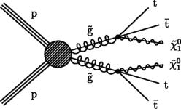
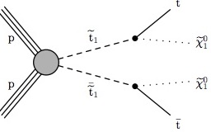
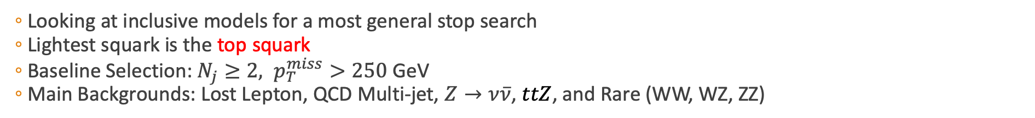
Simplified SUSY Models
Looking at inclusive models for a most general stop search
Lightest squark is the top squark
Baseline Selection: $N_{j}≥2, p_{T}^{miss}>250$ GeV
Main Backgrounds: Lost Lepton, QCD Multi-jet, $Z→ν\overline{ν}$, $ttZ$, and Rare (WW, WZ, ZZ)
Gluino Mediated Top squark Production
Direct Top Squark Production
Notes:
For T1tttt and T1ttbb it is an off-shell top that then decays to top(bottom) and a neutralino.

Slide 12
Outline
Standard Model
What is it?
Dark Matter
Why SUSY?
Compact Muon Solenoid
Different methods of detection
All-hadronic Top Squark Search
Kinematic Variables
Search region design
Background estimation

Slide 13
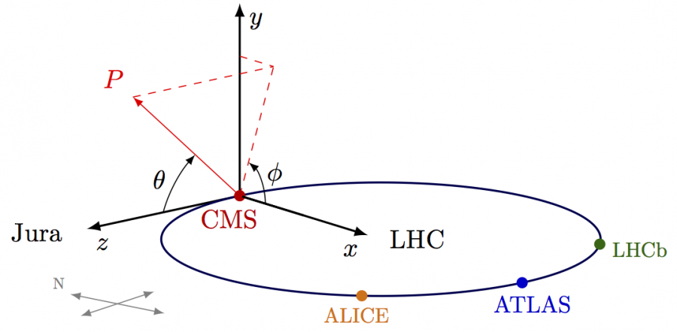
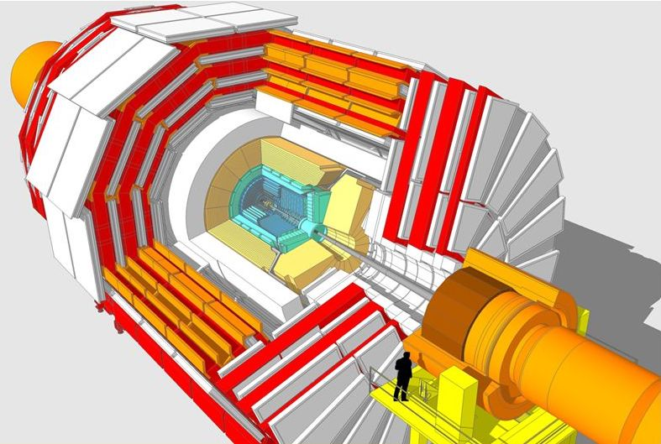
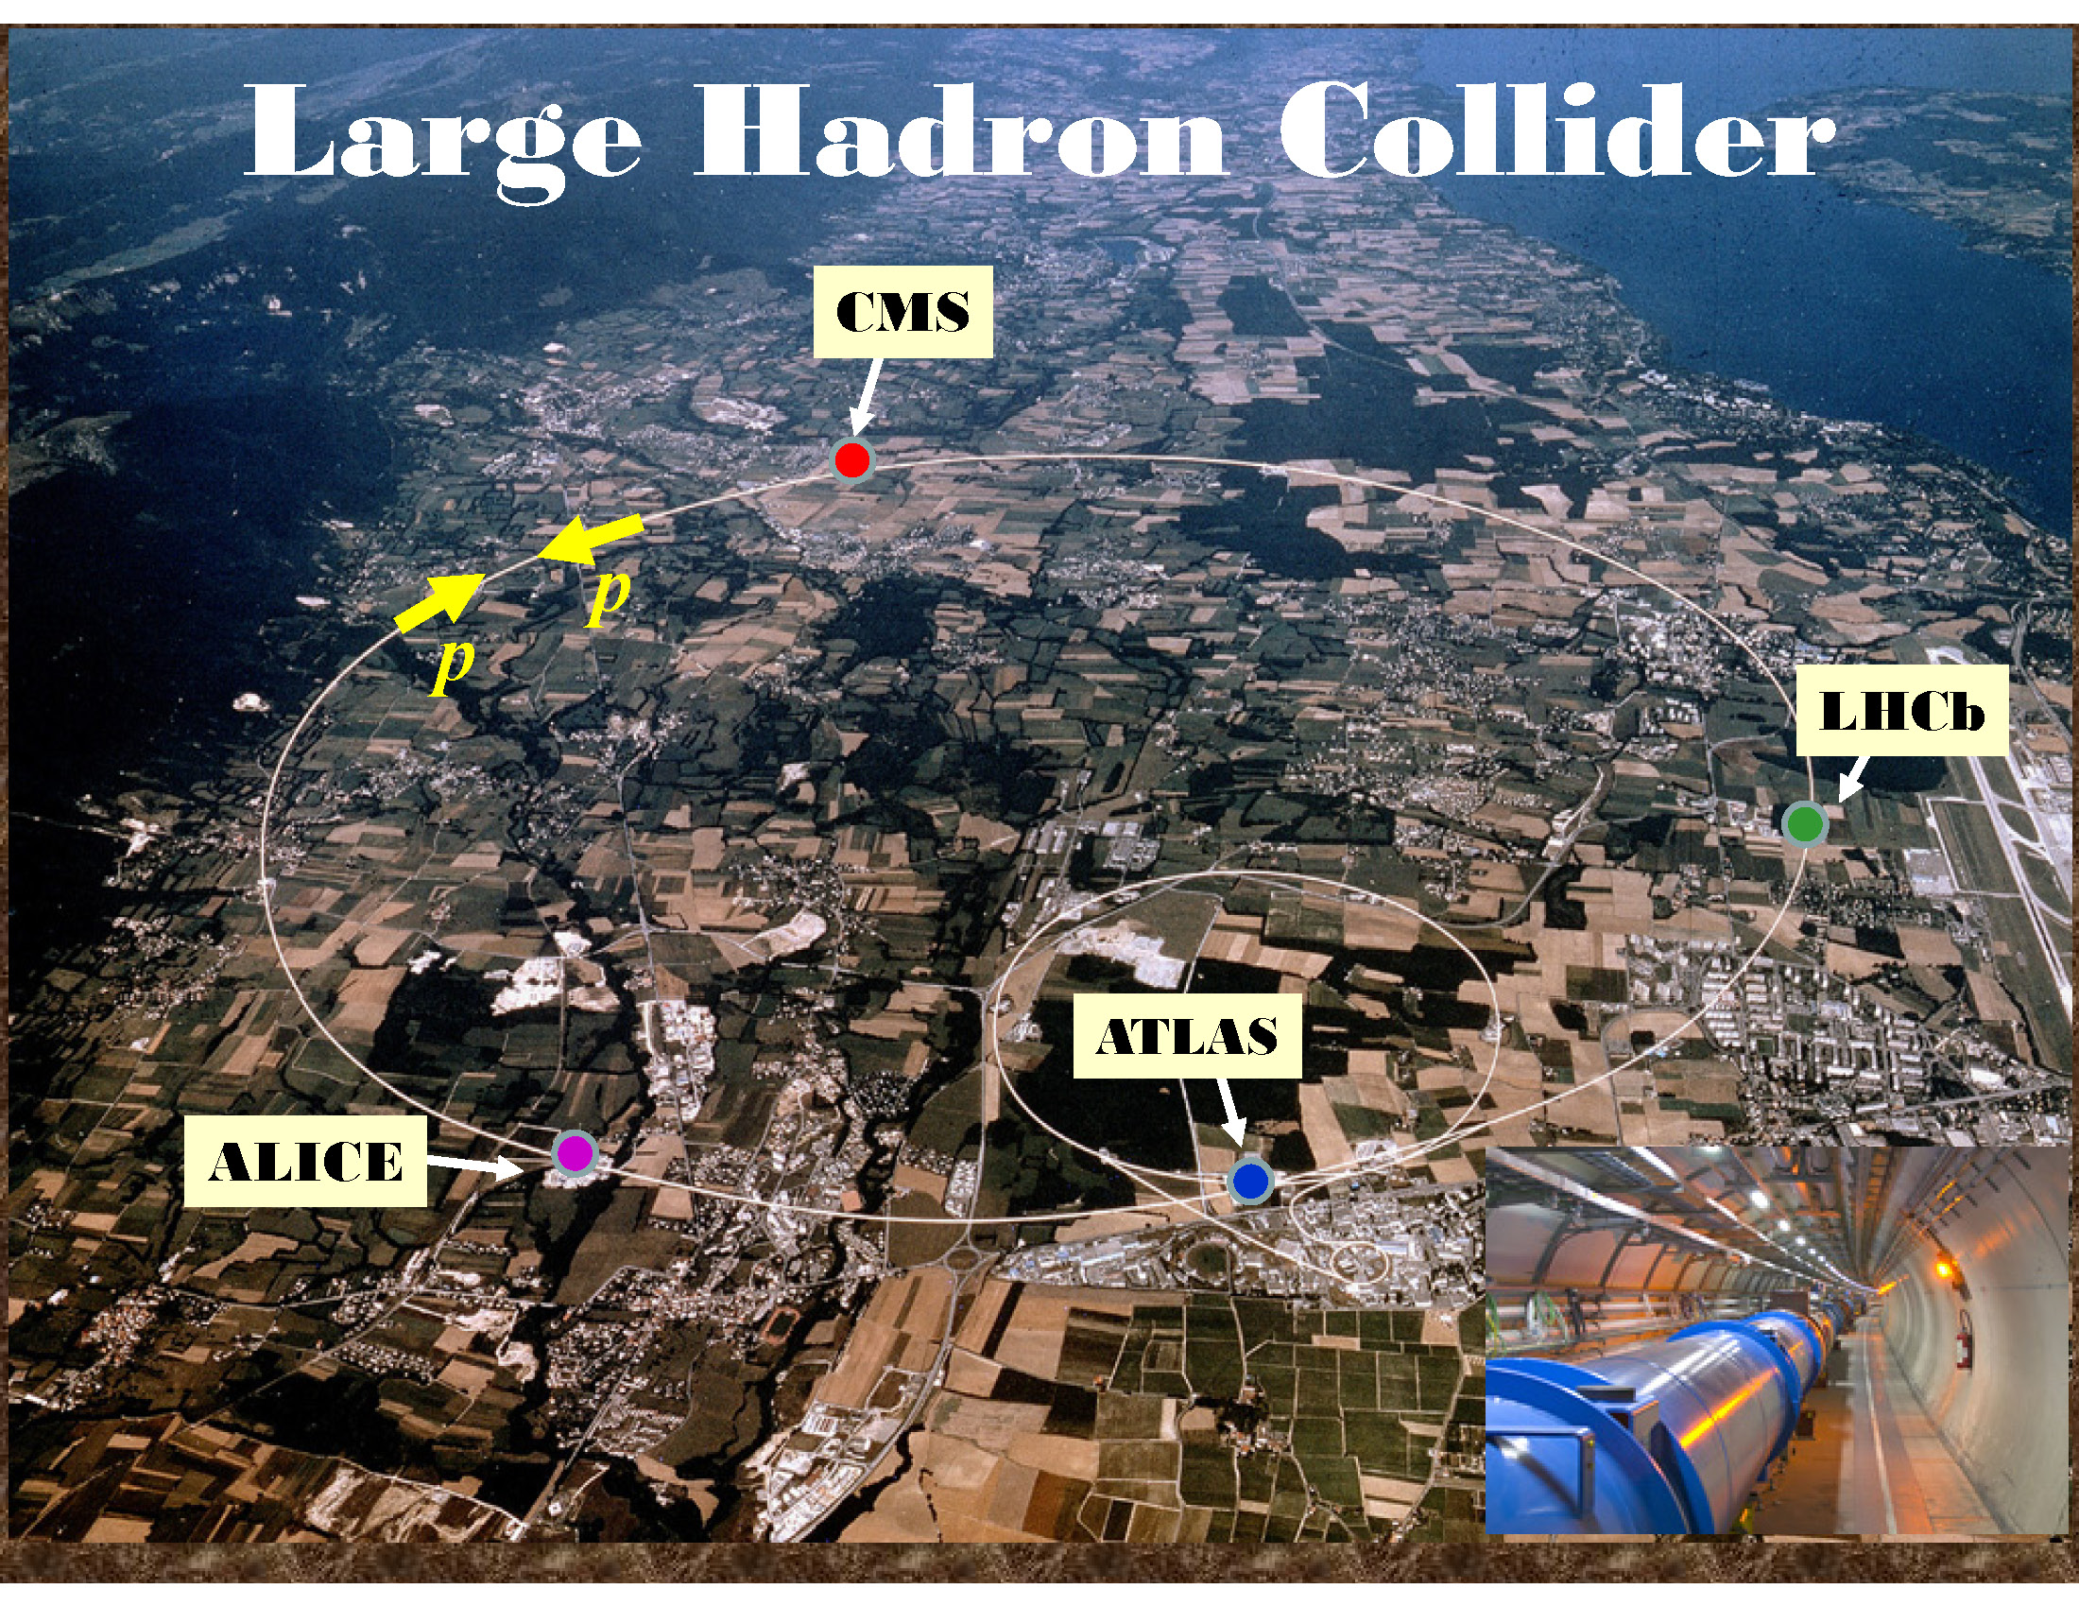
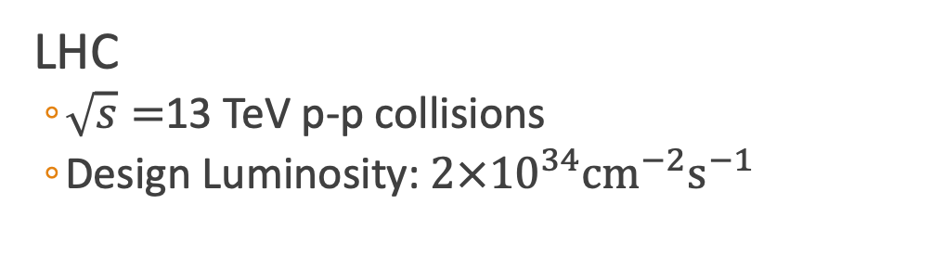
Compact Muon Solenoid (CMS)
LHC
$\sqrt{s}=$13 TeV p-p collisions
Design Luminosity: $2×{10}^{34}{\text{cm}}^{−2}{\text{s}}^{−1}$

Slide 14
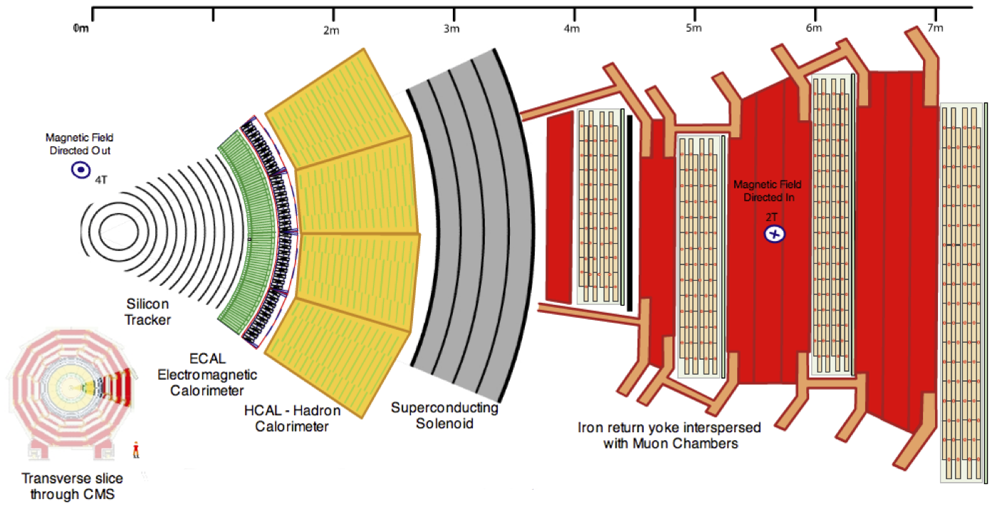
CMS Detector
CMS-doc-5582-v1

Slide 15

Muon Interaction
CMS-doc-5582-v1

Slide 16
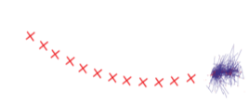
Electron Interaction
CMS-doc-5582-v1

Slide 17
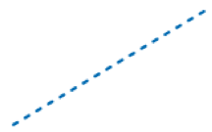

Photon Interaction
CMS-doc-5582-v1
Notes:
Could have conversions of photon to photon + electron

Slide 18
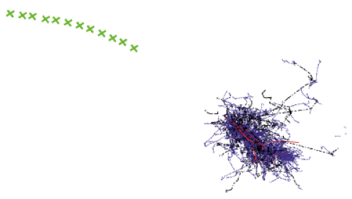
Charged Hadron Interaction
CMS-doc-5582-v1

Slide 19
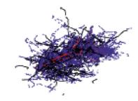

Neutral Hadron Interaction
CMS-doc-5582-v1

Slide 20
Outline
Standard Model
What is it?
Dark Matter
Why SUSY?
Compact Muon Solenoid
Different methods of detection
All-hadronic Top Squark Search
Kinematic Variables
Search region design
Background estimation

Slide 21
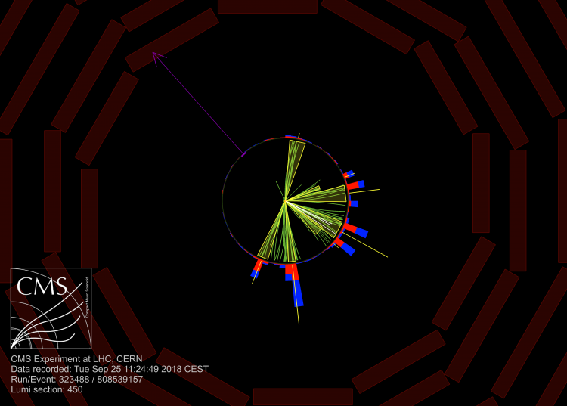
Example Event Signature
CMS-PAS-SUS-19-005

Slide 22
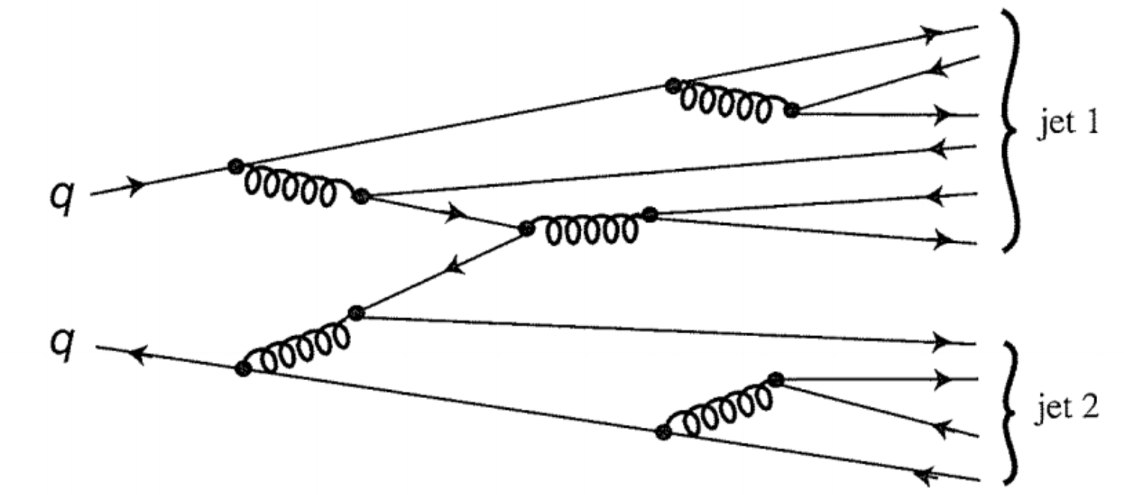
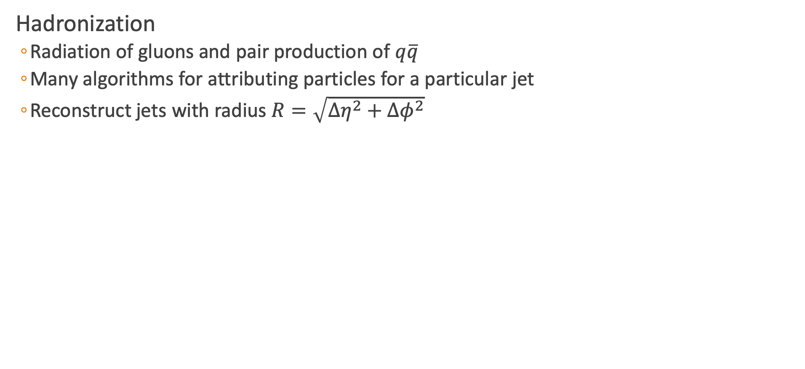
Jet Reconstruction
Hadronization
Radiation of gluons and pair production of $q\overline{q}$
Many algorithms for attributing particles for a particular jet
Reconstruct jets with radius $R=\sqrt{Δη^{2}+Δφ^{2}}$

Slide 23
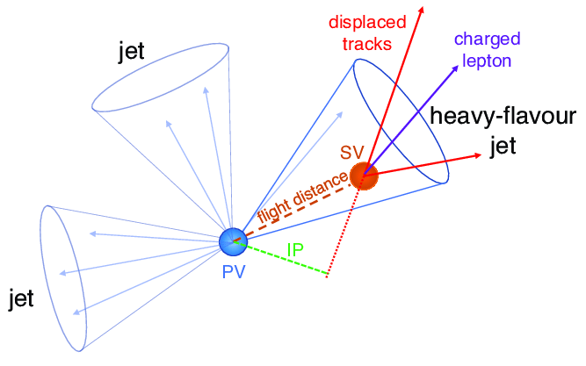
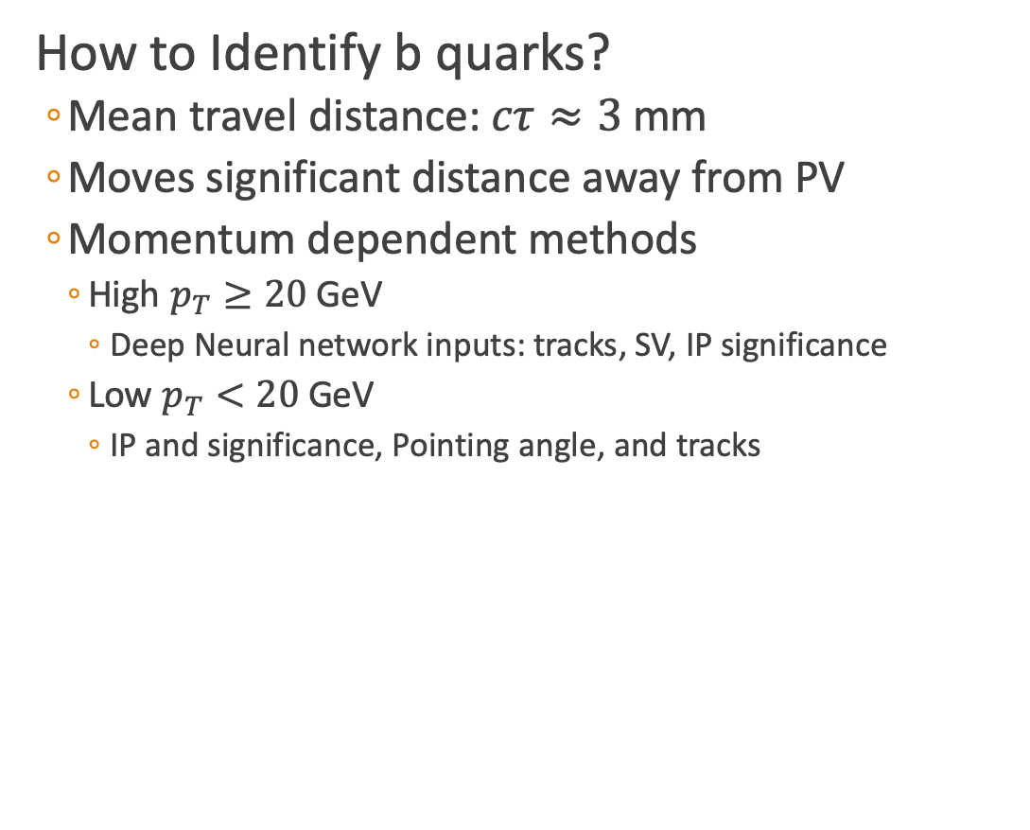
B Tagging
How to Identify b quarks?
Mean travel distance: $cτ≈3$mm
Moves significant distance away from PV
Momentum dependent methods
High $p_{T}≥20$ GeV
Deep Neural network inputs: tracks, SV, IP significance
Low $p_{T}<20$ GeV
IP and significance, Pointing angle, and tracks
Secondary
Vertex
Primary
Vertex
Impact
Parameter
arXiv:1712.07158
Notes:
Primary vertex: tracks are reconstructed from pixel seeds and clustered together based on the Z at the point of closest approach, verticies sorted by according to sum of pT^2 with largest first one being the primary vertex
Impact Parameter: distance between the the primary vertex and the track the the point of closest approach
Tracks: Look at distance of closest approach and angle between tracks
SV fitting: vertexes are fitted with adaptive vertex fitter and need 2D(3D) significance > 2.5(0.5)
SV 2D: 2D flight distance significance of the secondary vertex with the smallest uncertainty
nSV: number of secondary vertices
Track $η_{rel}$: the pseudorapidity of the track relative to the jet axis for the track
SV mass: mass of the SV with smallest uncertainty on its flight distance for jets
nTracks: number of tracks associated with the secondary vertex
SV energy ratio: SV energy / total energy of the jet
DeltaR(SV,jet): flight direction of SV and the jet
3D IP Significance:
Track pT: track pt relative to the jet axis
DeltaR(track,jet):
Track pT ratio: track pT/ track momentum vector for the track with the highest 2D impact parameter
Track distance:

Slide 24
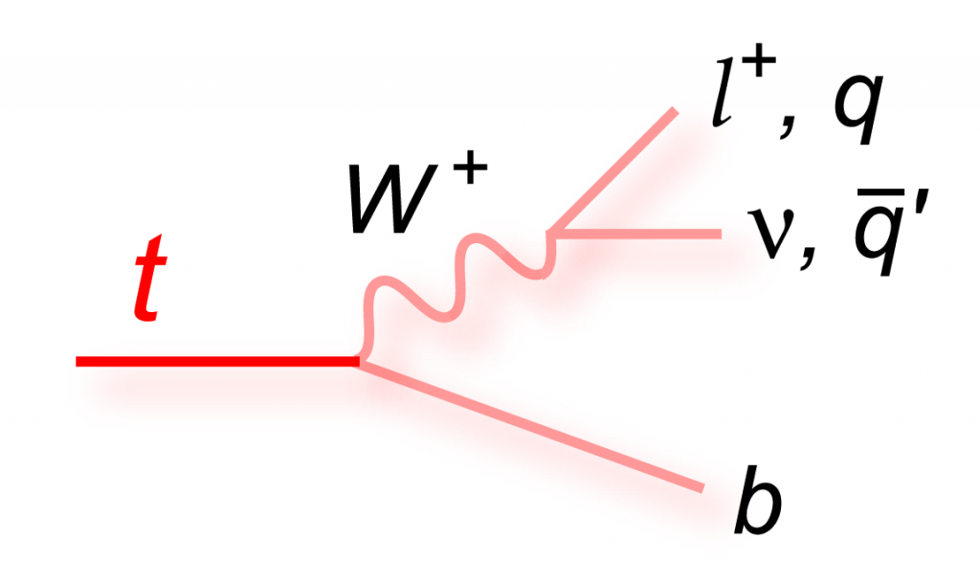
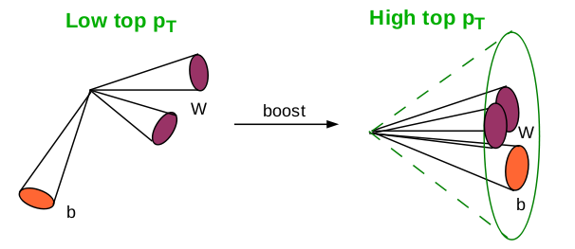
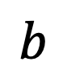
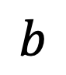
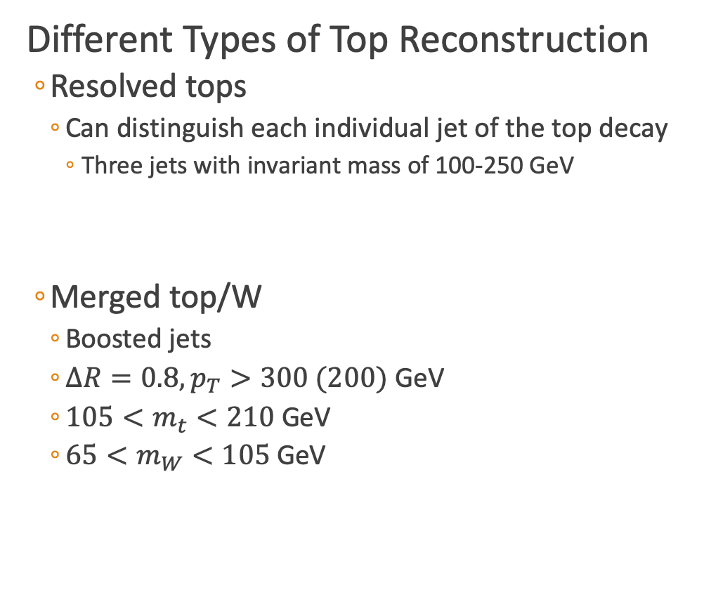
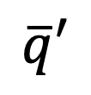
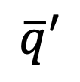
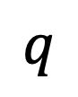
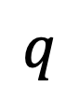


Heavy Object Tagging
$$q$$
Different Types of Top Reconstruction
Resolved tops
Can distinguish each individual jet of the top decay
Three jets with invariant mass of 100-250 GeV
Merged top/W
Boosted jets
$ΔR=0.8, p_{T}>300 (200)$ GeV
$105<m_{t}<210$ GeV
$65<m_{W}<105$ GeV
$$W^{+}$$
$$\overline{q}′$$
$$t$$
$$b$$
$$q$$
$$\overline{q}′$$
$$b$$
arXiv:1409.7495
JHEP v. 2014 p. 146, May 2014
Notes:
Soft Drop: Break the jet into two jets (undo the last step of clustering), check if pass the soft drop condition $\left(\frac{\min\left(P_{T1},p_{T2}\right)}{p_{T1}+p_{T2}}>z_{cut}{\left(\frac{ΔR_{12}}{R_{0}}\right)}^{β}\right).$
If pass then jet mass is total mass else redefine to largest pT and repeat

Slide 25

Missing Transverse Momentum
Vector sum of total momentum measured in the detector
${\vec{p}}_{T}^{miss}=−\sum_{i∈vis}{{\vec{p}}_{i,T}}$
Simplified SUSY: neutralino as source for missing tranverse momentum
SM: Neutrinos also escape detection
Phys. G: Nuclear and Particle Physics v.45 p. 063001
[3]

Slide 26


$$H_{T}$$
Scalar sum of total jet momentum
$H_{T}=\sum_{i∈jets}{p_{i,T}}$
Selection for massive particle decays
Background
Top quarks
DOI: 10.1103/PhysRevLett.74.2632
Notes:
Left: electron/muon + jets
Right: untagged single lepton + jets

Slide 27

Lepton Identification
Electrons
Look at energy deposits
Muons
Tracks matched to energy in muon chambers
Tau Decaying Hadronically
Isolated tracks
Neural Network
Tracker
Magnetic
Field
JINST 10 (2015) P06005 JINST 13 (2018) P06015 JINST 13 (2018) P10005 arXiv:1401.8155
Notes:
Tracker muon: propagate tracks to the muon system with a loose matching to DT or CSC segments, pT > 0.5 and p > 2.5 GeV.
Global muon: Muons reconstructed with information only from the muon chambers are matched to tracker tracks

Slide 28

Data Selection
Using data from all of Run 2 (2016/2017/2018) at CMS
$136.7 {\text{fb}}^{−1}≈136.7×{10}^{12}$ events
Each year is unique
Combine prediction for backgrounds

Slide 29



Classifying Interesting Regions
Categorize by $M_{T}\left(b_{1,2},p_{T}^{miss}\right)$
$M_{T}\left(b_{1,2},p_{T}^{miss}\right)=\sqrt{2∙p_{T}^{miss}∙p_{T}(b)(1−cos⁡(Δ{φ(p_{T}^{miss},p_{b})}_{ })}$
Low Mass Region
$M_{T}\left(b_{1,2},p_{T}^{miss}\right)<175$ GeV
High Mass Region
$M_{T}\left(b_{1,2},p_{T}^{miss}\right)>175$ GeV
$M_{T}\left(b_{1,2},p_{T}^{miss}\right)$
Notes:
HEM veto for HCAL Endcaps in which some modules became unresponsive

Slide 30



Targeted Search Regions
Direct Top Squark Production
Looking in low and high $Δm$ regions
Top Squark: $Δm=m_{\tilde{t}}−m_{\tilde{χ_{1}^{0}}}$
Search Regions
183 Search regions → 53 low + 130 high
Low $Δm$
High $Δm$
Backgrounds
Lost Lepton
QCD Multi-jets
$Z→ν\overline{ν}$
$ttZ$
Rare
$$m_{\tilde{t}}<m_{\tilde{χ_{1}^{0}}}$$

Slide 31


Lost Lepton Background
Standard Model Background
$t\overline{t},W+jets, tW, ttW$
Causes
Out of detector acceptance
Misidentification
Fails kinematics requirements
How to predict contribution for Run 2?

Slide 32
Lost Lepton Background
Standard Model Background
$t\overline{t},W+jets, tW, ttW$
Causes
Out of detector acceptance
Misidentification
Fails kinematics requirements
How to predict contribution for Run 2?
Missing
Momentum

Slide 33
Lost Lepton Background
Standard Model Background
$t\overline{t},W+jets, tW, ttW$
Causes
Out of detector acceptance
Misidentification
Fails kinematics requirements
How to predict contribution for Run 2?
Missing
Momentum
Lost
Lepton

Slide 34
Lost Lepton Background
Standard Model Background
$t\overline{t},W+jets, tW, ttW$
Causes
Out of detector acceptance
Misidentification
Fails kinematics requirements
How to predict contribution for Run 2?
Missing
Momentum
Lost
Lepton
Jets

Slide 35




Data versus Simulation Comparison
Run 2 Low $Δm$ Control Region
Run 2 High $Δm$ Control Region
$$p_{T}^{miss}$$
$$p_{T}^{miss}$$

Slide 36

Determining the Transfer Factor
LL Contribution
Control region (CR): $N_{lep}=1, M_{T}\left(l,p_{T}^{miss}\right)<100$ GeV
Search region (SR): $N_{lep}=0$
$N_{pred}^{LL}=\frac{N_{MC}(0l)}{N_{MC}(1l)}∙N_{data}(1l)$
Transfer Factor
Number of

Slide 37




Lost Lepton Control Region Comparison
Low $Δm$ CR
High $Δm$ CR
$$p_{T}^{miss}$$
$$p_{T}^{miss}$$

Slide 38



QCD Multi-jet Background
Missing Energy from the mismeasurement of jets
QCD Estimation used Transfer Factor method where:
Control Region: $Δφ(j_{123},p_{T}^{miss}$) < 0.1
Transfer Factor
$N_{pred}^{QCD}=\frac{N_{MC}^{QCD}\left(SR\right)}{N_{MC}^{QCD}\left(CR\right)}∙(N_{data}−N_{MC}^{non−QCD})$
Take MC events and do smearing (from 2 leading jets)
Statistical Uncertainty for the TF
Increasing the effective luminosity with a method called “local smearing”
$$p_{T}^{miss}$$
Meas. jet
True jet
$$Δφ$$
Meas. jet
Transfer Factor
Meas. jet

Slide 39

QCD Smearing Method
Methods based on the jet response function
Parameterize jet reconstruction
Binned in $p_{T}$ and jet flavor
Local Smearing
Consider the two leading jets
Start at jet response for standard MC ( )
Sample in window ( )
Recalculate variables jet($p_{T},φ,η),p_{T}^{miss},p_{φ}^{miss}$
Does not bias jet quantities
Probability

Slide 40




QCD Control Region Comparison
Low $Δm$ CR
High $Δm$ CR
$$p_{T}^{miss}$$
$$p_{T}^{miss}$$

Slide 41


Data versus Predicted Simulation
Low $Δm$
Validate background estimation
${250<p}_{T}^{miss}<350(400)$ GeV
Relaxed cuts compared to search region

Slide 42


Data versus Predicted Simulation
High $Δm$
Validate background estimation
${250<p}_{T}^{miss}<400$ GeV
$p_{T}^{miss}>400$ GeV
Relaxed cuts compared to search region

Slide 43


Hypothesis Testing
Likelihood function
$ℒ\left(μ,θ\right)=\prod_{i}{\frac{{\left[μ∙s_{i}\left(θ\right)+b_{i}\left(θ\right)\right]}^{n_{i}}}{n_{i}!}e^{−\left[μ∙s_{i}\left(θ\right)+b_{i}\left(θ\right)\right]}}\prod_{κ}{e^{−\frac{1}{2}θ_{κ}^{2}}}$
${\tilde{q}}_{μ}=−2\text{ln}\frac{ℒ\left(μ,{\hat{θ}}_{μ}\right)}{ℒ\left(μ,θ\right)}$
Log Normal:
Calculate the confidence levels for each signal region
$p_{μ}=P\left({\tilde{q}}_{μ}≥{\tilde{q}}_{μ}^{obs} | \text{signal}\text{+}\text{background}\right)=\int_{{\tilde{q}}_{μ}^{obs}}^{∞}{f\left({\tilde{q}}_{μ} | μ,{\hat{θ}}_{μ}^{obs}\right)d{\tilde{q}}_{μ}}$
$1−p_{μ}=P\left({\tilde{q}}_{μ}≥{\tilde{q}}_{μ}^{obs} | \text{background}\text{−}\text{only}\right)=\int_{{\tilde{q}}_{μ}^{obs}}^{∞}{f\left({\tilde{q}}_{μ} | 0,{\hat{θ}}_{0}^{obs}\right)d{\tilde{q}}_{μ}}$
$CL_{s}\left(μ\right)=\frac{p_{μ}}{1−p_{b}}$
Look for $CL_{s}=0.05$
Systematic | Signal | Lost Lepton
Initial State Radiation | ~15-30% | ~1-5%
B tagging | ~2-8% | ~1-7%
Resolved Tops | ~1-7% | ~1-9%
Merged Tops | ~1-8% | ~1-7%
Merged W | ~1-10% | ~1-8%
Notes:
Log normal is good because it avoids all difficulties of a truncated Gaussian, which can go negative. Not good for cross section.
Good for regions with very large uncertainty

Slide 44
Expected Limits for Direct Top Squark
Direct Top Squark Production

Slide 45
Observed Limits for Direct Top Squark
Direct Top Squark Production

Slide 46

Comparing with Previous Analysis

Slide 47

Comparing with Previous Analysis

Slide 48
Observed Limits with Gluino Mediated Top Squark
Gluino Mediated Top Squark Production

Slide 49

Observed Limits with Gluino Mediated Top Squark

Slide 50

Observed Limits with Gluino Mediated Top Squark

Slide 51

Summary
Completed analysis on direct and gluino mediated top squark production
136.7 /fb from Run 2 of CMS
Comprehensive search for top squark and SUSY
Improved limits from previous studies
Direct top Squark$:m_{\tilde{t}}=1175$ GeV at minimal neutralino mass
Gluino Mediated$:m_{\tilde{g}}=2050$ GeV at minimal neutralino mass
Sensitive to low mass spectra

Slide 52

Acknowledgements
Advisor: Karl Ecklund
Committee Members: Paul Padley and David Scott
Rice Bonner Lab:
Bora Akgun
James Zabel
Jamal Rorie
Wei Shi
Sven Dildick
Matthew Decaro
CMS Collaboration

Slide 53

Acknowledgements
Advisor: Karl Ecklund
Committee Members: Paul Padley and David Scott
Rice Bonner Lab:
Bora Akgun
James Zabel
Jamal Rorie
Wei Shi
Sven Dildick
Matthew Decaro
CMS Collaboration

Slide 54
















Thanks Family and Friends

Slide 55
Backup

Slide 56



${\tilde{t}}_{1}$: Dynamic Reason to be at bottom of sParticles
Quark left and right superpartners can strongly mix to form mass eigenstates
$M_{\tilde{t_{1}}}^{2}=\left(\begin{matrix}{\tilde{M}}_{Q_{3}}^{2}+M_{t}^{2}+M_{Z}^{2}\left(\frac{1}{2}−\frac{2}{3}\sin^{2}{θ_{W}}\right)cos2β & v\left(a_{t}^{∗}sinβ−μy_{t}cosβ\right) \\ v\left(a_{T}^{∗}sinβ−μy_{t}cosβ\right) & {\tilde{M}}_{{\overline{u}}_{3}}^{2}+M_{t}^{2}+\frac{2}{3}M_{Z}^{2}\sin^{2}{θ_{W}cos2β}\end{matrix}\right)$
Strong mixing in the stop sector
Could lead to ${\tilde{t}}_{1}$being the lightest squark
Notes:
Y_t is the Yukawa coupling(interaction between a scalar field and Dirac field),

Slide 57


The Tracker Detector
Outer Tracker
Active area: 200 ${\text{m}}^{2}$, 15148 modules
10 layers in barrel region
9 + 3 in inner disks and endcaps
Analog readout
Phase 1 Pixel Tracker
4 barrel layers
3 endcap disks on each side
124 million pixel channels
Digital Readout

Slide 58




Phase 1 Pixels
Replaced in winter 2016/2017
Approximately 1 m long
Designed for peak luminosity of $2.5×{10}^{34}{ \text{cm}}^{−2}{\text{s}}^{−1}$ with 50 ns bunch crossings
Analog $→$ digital
New data acquisition (DAQ)
DCDC powering
${\text{CO}}_{2}$ cooling
Light weight
Cost effective
Layer 1 closer to beam line
43 mm to 30 mm
Layer 4 extends to 160 mm

Slide 59




Simplified SUSY Models
Looking at inclusive models for a most general stop search
Gluino Mediated Stop Production
Direct Stop Production
Notes:
For T1tttt and T1ttbb it is an off-shell top that then decays to top(bottom) and a neutralino.

Slide 60

Stop Cross Section
Cross section-probability that two particles will collide and react a certain way

Slide 61


Anti-kT Algorithm
Distance calculation
$d_{ij}=\text{min}(k_{Ti}^{−2},k_{Tj}^{−2})\frac{{\left(y_{i}−y_{j}\right)}^{2}+{\left(φ_{i}−φ_{j}\right)}^{2}}{R^{2}}$
$d_{iB}=k_{Ti}^{−2}$
Infrared safe
Circular jet area
Notes:
Infrared safe: reconstruction is unaffected by soft radiation of photons
Jet area: unaffected by soft radiation, low pT photons will not have a min from the above
P = 1: Inclusive kT algorithm
P = 0: Inclusive Cambridge/Aachen algorithm

Slide 62

QCD Jet Mistag Rate

Slide 63

Tau Identification
time
space
Tau Decays are Interesting
17% of decays to leptons
51% is 1 prong hadronic decays
15% is 3 prong hadronic decays
Identify taus
Isolated tracks using charged hadrons
TauPOG Neural Network
[5]
Notes:
Must be odd pronginess to conserve charge

Slide 64
Identification of Leptons
Isolation Methods
Electrons and muons are isolated
Measurements in Electromagnet Calorimeter and Muon Chambers, respectively
Using recommendations by CMS
Hadronic Taus
Looking at isolated charged hadrons
Boosted Decision Trees (BDT)
Training is matched gen level taus from 2017 TTbar simulation
Good discrimination between taus and other particles
CMS Work in progress

Slide 65

Tau MVA
Comparison of three hadronically decaying tau tagging methods
Custom MVA identifying charged hadron candidates
Custom BDT trained on ttbar 2017 samples to identify hadronically decaying taus
Isotrack using cut-based methods
Isotrack+tauPOG identification
$\text{Veto} \text{percent} =1 − \frac{N_{τ=0}}{N_{τ≥0}}$
$\text{Efficiency} =\frac{(N_{τ>0} \&\& N_{τ>0}^{gen})}{N_{τ>0}^{gen}}$
 | ttbar 1-lep Background |  | T2tt(850, 100) |  | T2tt(500, 325)
Methods | Veto Percentage | Veto Efficiency | Veto Percentage | Veto Efficiency | Veto Percentage | Veto Efficiency
Custom MVA | 32.2% | 57.7% | 6.5% | 10.9% | 27.6% | 39.4%
IsoTrack | 21.3% | 37.9% | 2.6% | 6.6% | 8.9% | 22.6%
IsoTrack + TauPOG | 29.0% | 49.1% | 7.2% | 22.6% | 14.6% | 37.3%

Slide 66

Baseline Selection
Lepton Selection
Veto ID electron: $p_{T}>5$ GeV, $\left|η\right|<2.5$
Loose muon: $p_{T}>5$ GeV, $\left|η\right|<2.5$
IsoTrack: cut based charged PF candidate
TauPOG: $p_{T}>20$ GeV, $\left|η\right|<2.4$, medium working point
$N_{j}\left(p_{T}>20 \text{GeV}\right)≥2,\left|η\right|<2.4$
$Δφ\left(j_{1},p_{T}^{miss}\right)>0.5,Δφ\left(j_{23},p_{T}^{miss}\right)>0.15$
$p_{T}^{miss}>250$ GeV
$H_{T}>300$ GeV
HEM Veto: $η\left[−3,−1.4\right], φ\left[−1.57,−0.87\right],p_{T}>20$ GeV applied to jets, electrons, and photons
Bjets: DeepCSV medium working point
W/Top: deepAK8 tight working point
Deep Resolved Top: tight working point
Scale Factors: PUWeights, BtagWeights, resTop/Top/W, soft btaggin, ISRWeights (2016), PrefireWeights (2016/2017) for all backgrounds

Slide 67



Search Strategy
Categorize low $Δm$ and high $Δm$ by $M_{T}\left(b_{1,2},p_{T}^{miss}\right)$
Low $Δm$
$M_{T}\left(b_{1,2},p_{T}^{miss}\right)<175$ GeV
Veto Tops and W
ISR Tagging
Soft-b tagging
$N_{j}≥2$
$Δφ\left(j_{1},p_{T}^{miss}\right)>0.5, Δφ\left(j_{23},p_{T}^{miss}\right)>0.15$
$\frac{p_{T}^{miss}}{\sqrt{H_{T}}}>10$
High $Δm$
$M_{T}\left(b_{1,2},p_{T}^{miss}\right)>175$ GeV
Top and W tagging
$N_{j}≥5,N_{b}≥1$
$Δφ\left(j_{1234},p_{T}^{miss}\right)>0.5$
Notes:
HEM veto for HCAL Endcaps in which some modules became unresponsive

Slide 68

Low Mass Region

Slide 69

High Mass Region

Slide 70
Lost Lepton Inclusive Low DM

Slide 71
Lost Lepton Inclusive High DM

Slide 72


Example LL Prediction

Slide 73


Z to Invisible
Events with jets and a Z decaying to two neutrinos
Large $H_{T}$ and $p_{T}^{miss}$, similar to signal
Control Region
$Z→ll+\text{jets}\text{: }R_{Z}$(Z Normalization factor)
Use in low mass $N_{b} \text{and} N_{SV}$
Calculate $t\overline{t}$ normalization $R_{t}$
Photon + jets: $S_{γ}$($p_{T}^{miss}$ shape weight)
Use in low mass $N_{b} \text{and} N_{j}$
Reconstructed $Z \text{or} γ$ is added to $p_{T}^{miss}$ for $Z→ν\overline{ν}$
$$N_{pred}^{Z→ν\overline{ν}}=N_{MC}^{Z→ν\overline{ν}}∙R_{Z}{∙S}_{γ}$$
Notes:
Z decaying to neutrinos to get missing energy.
Z to dilepton control region and a Photon control region.
Possible systematics: Rz for normalization, Zgamma for physics differences between physics processes
Z to leptons: 3.3%
Z to nunu: 20.0%
Z to hadrons: 69.911%

Slide 74



Z to Invisible: Normalization ($R_{Z}$)
Normalization $R_{Z}$ is calculated in the $Z→ll$ control region
Calculated for electrons and muons separately
Weighted average is combined
How to calculate?
Reconstruct Z from leptons
Two regions
On Z mass: $81<m_{ll}<101$ GeV
Off Z mass: $50<m_{ll}<81$ GeV and $m_{ll}>101$ GeV
$\left[\begin{matrix}Data_{on−Z} \\ Data_{off−Z}\end{matrix}\right]=\left[\begin{matrix}MC_{on−Z}(Z→ll) & MC_{on−Z}(t\overline{t}) \\ MC_{off−Z}(Z→ll) & MC_{off−Z}(t\overline{t})\end{matrix}\right]∙\left[\begin{matrix}R_{Z} \\ R_{T}\end{matrix}\right]$

Slide 75


Comparison of Z Normalization for Muons
Notes:
We calculated the normalization and calculate a weighted average. We calculate the Z mass and bin in the Z mass peak. Solve the matrix and only Rz in the final prediction. Some difference but in agreement in general

Slide 76


Photon Shape Corrections

Slide 77


Comparison of Normalization
Notes:
Reduced chi squared is the constant fit which is used to get a scaling factor which is a method S = sqrt(xhi^2)

Slide 78


QCD Control Region Comparison

Slide 79



Rare Background
3 lepton channels to validate $ttZ$ contribution
Also contribution from diboson (WW, WZ, and ZZ)
Notes:
Signal contamination near zero due to the Z mass requirement

Slide 80

Low DM Validation Region

Slide 81

High DM Validation

Slide 82


Validation Pulls

Slide 83

Systematics
Systematic | Signal | Lost Lepton | QCD Multijet | $$Z→ν\overline{ν}$$ | Rare
Initial State Radiation | ~15-30% | ~1-5% | ---- | ---- | ----
B tagging | ~2-8% | ~1-7% | ~3-5% | ~1-10% | ~1-8%
Resolved Tops | ~1-7% | ~1-9% | ~1-25% | ~8-16% | ~5-12%
Merged Tops | ~1-8% | ~1-7% | ~1-10% | ~4-9% | ~1-10%
Merged W | ~1-10% | ~1-8% | ~1-5% | ~1-14% | `1-8%
Log Normal Distribution:
Notes:
Log normal is good because it avoids all difficulties of a truncated Gaussian, which can go negative. Not good for cross section.
Good for regions with very large uncertainty

Slide 84

Datacard Calculation

Slide 85
Datacard Calculation

Slide 86
Datacard Calculation

Slide 87
Datacard Calculation

Slide 88
Datacard Calculation

Slide 89

Example Calculation for Single Bin
Total yield of background
N=3042.65(LL)+7457.98(Znunu)+690.827(QCD)+0.390779(ttZ)+196.672(Diboson)
N=11388.52
Stat. Uncertainty = 0.0066(LL)+0.0027(Znunu)+0.03078(QCD)+0.10877(ttZ)+0.03485(Diboson)
Stat. Uncertainty = 68.40 (sum of weights squared)
$μ=\frac{\sum{w_{i}x_{i}}}{\sum{w_{i}}}$ where $x_{i}=$ stat uncertainty
SimpleSyst. Uncertainty =

